Slide 1
Issues With Memory

Slide 2
Forgetting
Forgetting is the inability to recall or recognize previously encoded information. Although some instances of forgetting are due to poor initial encoding, and others are due to the lack of the right cues at the right time, many instances of forgetting result from postencoding mechanisms.

Slide 3
Forgetting
Question: why is it good that we forget?

Slide 4
Forgetting
In his classic work Memory (1885/1964), Hermann Ebbinghaus systematically examined how memory for encoded stimuli and events changes as the retention interval—the time between encoding and retrieval—increases.

Slide 5
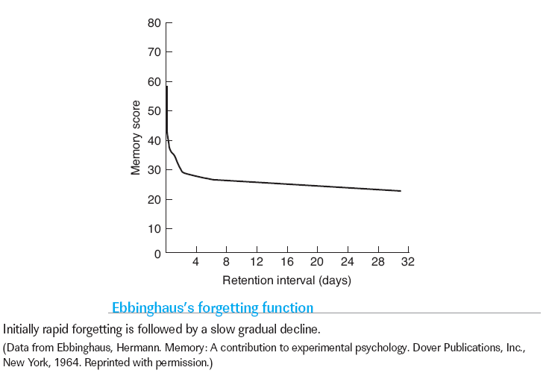

Forgetting

Slide 6
Theories
Decay Theory
Interference Theory
Motivated Forgetting Theory
Encoding Failure Theory
Retrieval Failure Theory

Slide 7
Decay Theory
Neurons Die
Use it or Lose it!
Memories Decay over time

Slide 8
Decay Theory
Time alone is not the reason why we forget.
  Remember your 21st birthday?
  When a sibling was born?

Slide 9
Interference Theory
Competition of information - same cue is bound to several representations.
So they compete (fight!) at retrieval.

Slide 10
Interference Theory
Retroactive interference - new learning results in the inability to remember previously learned information
Previously learned information can interfere with memory for information learned later by proactive interference.

Slide 11
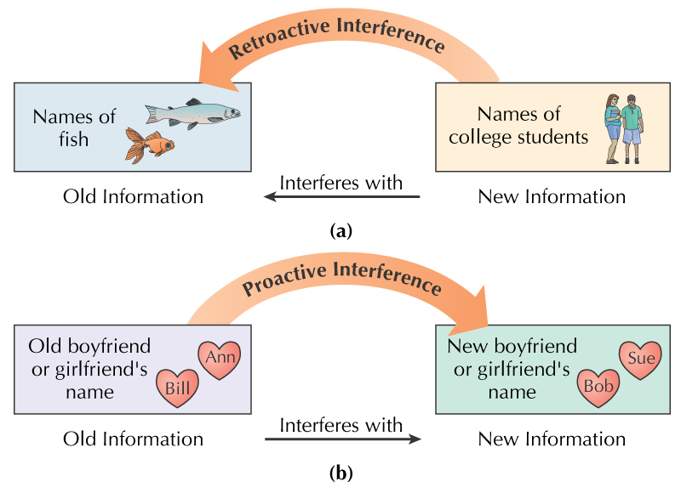
Interference Theory
Retroactive Interference - new interferes with old
Proactive Interference - old interferes with new

Slide 12
Motivated Forgetting Theory
Suppression - active weakening of memory , occurs because the act of retrieval is competitive: to retrieve a desired memory (your school password) you must not only strengthen its representation, you also must suppress the representations of competing associates (your earlier password).

Slide 13
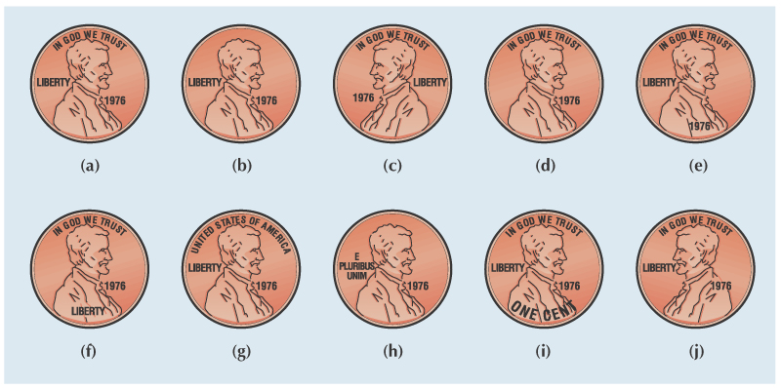

Vote for the Right Penny!

Slide 14
Encoding Failure
Penny study
STM to LTM breakdown

Slide 15
Retrieval Failure Theory
Tip of the Tongue
LTM to STM failure

Slide 16
7 Sins of Memory (Schacter, 1999)
3 related to forgetting
  Transience
  Absent-mindedness
  Blocking
3 related to distortion or inaccuracy
  Misattribution
  Suggestibility
  Bias
1 other
  Persistence

Slide 17
Transience
“I had it here, somewhere. Where has it gone…”
Gradual loss over time
Retention curve follows a power function

Slide 18
Absent-mindedness
“POOP! Its not even in there!”
Lapses of attention during encoding means that the information is not in LTM
Commonly occurs during automatic actions

Slide 19
Blocking
Name all the animals you can think of that start with the letter E.

Slide 20
Blocking
How many did you write down?

Slide 21
Blocking
In reality there are “30ish”

Slide 22
Blocking
Forgetting can be caused by the blocking of a memory representation, that is, by obstruction that can occur when multiple associations are associated with a cue and one of those associations is stronger than the others, preventing retrieval of the target information.

Slide 23
Blocking
Output interference is the strengthening of memories provided by the act of initial retrieval blocks the retrieval of other memories.
Retrieval-induced forgetting, forgetting that occurs when a memory is suppressed during the retrieval of another memory

Slide 24
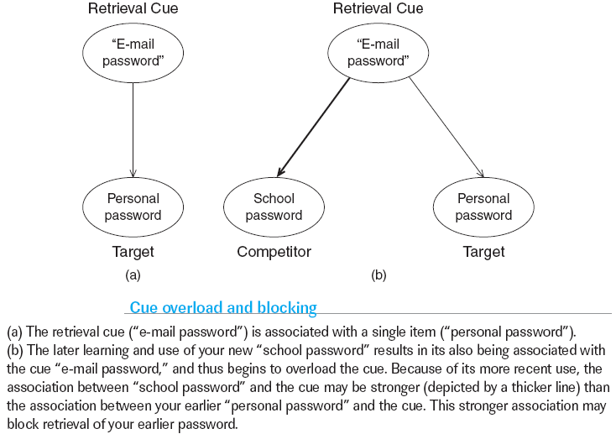
Blocking and Suppression
Chapter 5
Notes:
Ample evidence indicates that many instances of forgetting are caused by interfer­ence. Interference theories hold that if the same cue is bound to a number of repre­sentations, these representations compete during retrieval, resulting in interference. Newer memories interfere with older ones, and older ones with newer ones; and the re­sult is that neither old nor new stimuli or events are perfectly recalled—even though the information is still in memory, we have forgotten because retrieval attempts have failed. (p. 225)

Slide 25
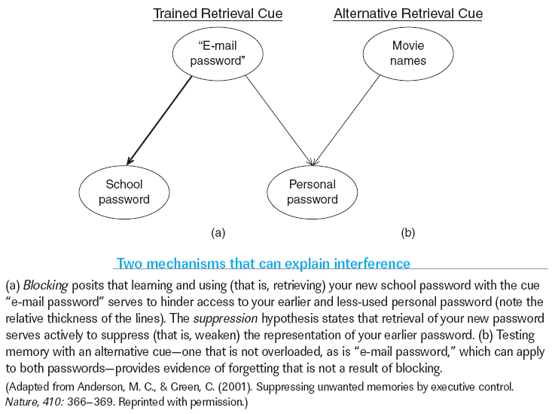
Blocking and Suppression
Chapter 5
Notes:
Ample evidence indicates that many instances of forgetting are caused by interfer­ence. Interference theories hold that if the same cue is bound to a number of repre­sentations, these representations compete during retrieval, resulting in interference. Newer memories interfere with older ones, and older ones with newer ones; and the re­sult is that neither old nor new stimuli or events are perfectly recalled—even though the information is still in memory, we have forgotten because retrieval attempts have failed. (p. 225)

